Slide 1
PIPELINING AND VECTOR PROCESSING
Parallel Processing
Pipelining
Arithmetic Pipeline
Instruction Pipeline
RISC Pipeline
Vector Processing
Array Processors(refer book)

Slide 2
PARALLEL PROCESSING
Parallel Processing
  Execution of Concurrent Events in the computing
  process to achieve faster Computational Speed
Levels of Parallel Processing
- Job or Program level
- Task or Procedure level
- Inter-Instruction level
- Intra-Instruction level

Slide 3
PARALLEL COMPUTERS
Parallel Processing
Architectural Classification
  Flynn's classification
    Based on the multiplicity of Instruction Streams and Data Streams
    Instruction Stream
      Sequence of Instructions read from memory
    Data Stream
      Operations performed on the data in the processor
Number of Data Streams
Single
Multiple
Number of
Instruction
Streams
Single
SISD
SIMD
Multiple
MISD
MIMD

Slide 4
COMPUTER ARCHITECTURES FOR PARALLEL PROCESSING
Parallel Processing
Von-Neuman
based
Dataflow
Reduction
SISD
MISD
SIMD
MIMD
Superscalar processors
Superpipelined processors
VLIW
Nonexistence
Array processors
Systolic arrays
Associative processors
Shared-memory multiprocessors
Bus based
Crossbar switch based
Multistage IN based
Message-passing multicomputers
Hypercube
Mesh
Reconfigurable

Slide 5
SISD COMPUTER SYSTEMS
Parallel Processing
Control
Unit
Processor
Unit
Data stream
Memory
Instruction stream
Characteristics
- Standard von Neumann machine
- Instructions and data are stored in memory
- One operation at a time
Limitations
Von Neumann bottleneck
Maximum speed of the system is limited by the
Memory Bandwidth (bits/sec or bytes/sec)
- Limitation on Memory Bandwidth
- Memory is shared by CPU and I/O

Slide 6
MISD COMPUTER SYSTEMS
Parallel Processing
M
CU
P
M
CU
P
Memory
•
•
•
•
•
•
M
CU
P
Data stream
Instruction stream
Characteristics
- There is no computer at present that can be
classified as MISD

Slide 7
SIMD COMPUTER SYSTEMS
Parallel Processing
Memory
Data bus
Control Unit
Instruction stream
P
P
• • •
P
Processor units
Data stream
Alignment network
M
M
• • •
M
Memory modules
Characteristics
- Only one copy of the program exists
- A single controller executes one instruction at a time

Slide 8
MIMD COMPUTER SYSTEMS
Parallel Processing
P
M
P
M
• • •
P
M
Interconnection Network
Shared Memory
Characteristics
- Multiple processing units
- Execution of multiple instructions on multiple data
Types of MIMD computer systems
- Shared memory multiprocessors
- Message-passing multicomputers

Slide 9
PIPELINING
Pipelining
  A technique of decomposing a sequential process
  into suboperations, with each subprocess being
  executed in a partial dedicated segment that
  operates concurrently with all other segments.
A_{i} * B_{i} + C_{i} for i = 1, 2, 3, ... , 7
A_{i}
B_{i}
Memory
C_{i}
Segment 1
R1
R2
Multiplier
Segment 2
R3
R4
Segment 3
Adder
R5
R1 ← A_{i}, R2 ← B_{i} Load A_{i} and B_{i}
R3 ← R1 * R2, R4 ← C_{i} Multiply and load C_{i}
R5 ← R3 + R4 Add

Slide 10
OPERATIONS IN EACH PIPELINE STAGE
Pipelining
Clock
Pulse
Segment 1
Segment 2
Segment 3
  Number R1 R2 R3 R4 R5
  1 A1 B1
  2 A2 B2 A1 * B1 C1
  3 A3 B3 A2 * B2 C2 A1 * B1 + C1
  4 A4 B4 A3 * B3 C3 A2 * B2 + C2
  5 A5 B5 A4 * B4 C4 A3 * B3 + C3
  6 A6 B6 A5 * B5 C5 A4 * B4 + C4
  7 A7 B7 A6 * B6 C6 A5 * B5 + C5
  8 A7 * B7 C7 A6 * B6 + C6
  9 A7 * B7 + C7

Slide 11
GENERAL PIPELINE
Pipelining
General Structure of a 4-Segment Pipeline
Clock
Input
S
R
S
R
S
R
S
R
1
1
2
2
3
3
4
4
Space-Time Diagram
1
2
3
4
5
6
7
8
9
Clock cycles
Segment
1
T1
T2
T3
T4
T5
T6
2
T1
T2
T3
T4
T5
T6
3
T1
T2
T3
T4
T5
T6
4
T1
T2
T3
T4
T5
T6

Slide 12
PIPELINE SPEEDUP
Pipelining
  n: Number of tasks to be performed
Conventional Machine (Non-Pipelined)
  t_{n}: Clock cycle
  τ₁: Time required to complete the n tasks
  τ₁ = n * t_{n}
Pipelined Machine (k stages)
  t_{p}: Clock cycle (time to complete each suboperation)
  τ_{κ}: Time required to complete the n tasks
  τ_{κ} = (k + n - 1) * t_{p}
Speedup
  S_{k}: Speedup
S_{k} = n*t_{n} / (k + n - 1)*t_{p}
t_{n}
lim
S_{k} =
t_{p}
( = k, if t_{n} = k * t_{p} )
n → ∞

Slide 13
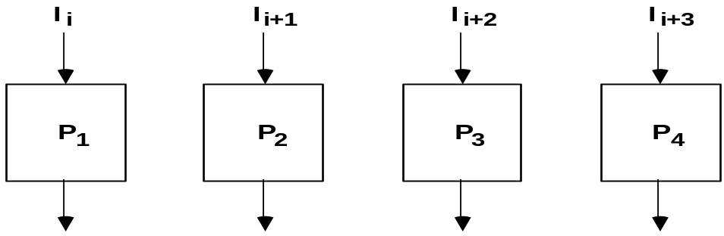
PIPELINE AND MULTIPLE FUNCTION UNITS
Pipelining
Example
- 4-stage pipeline
- subopertion in each stage; t_{p} = 20nS
- 100 tasks to be executed
- 1 task in non-pipelined system; 20*4 = 80nS
Pipelined System
(k + n - 1)*t_{p} = (4 + 99) * 20 = 2060nS
Non-Pipelined System
n*k*t_{p} = 100 * 80 = 8000nS
Speedup
S_{k} = 8000 / 2060 = 3.88
4-Stage Pipeline is basically identical to the system
with 4 identical function units
Multiple Functional Units

Slide 14
ARITHMETIC PIPELINE
Arithmetic Pipeline
Floating-point adder
Exponents
Mantissas
a
b
A
B
X = A x 2ª
Y = B x 2^{b}
R
R
[1] Compare the exponents
[2] Align the mantissa
[3] Add/sub the mantissa
[4] Normalize the result
Segment 1:
Compare
Difference
exponents
by subtraction
R
Segment 2:
Choose exponent
Align mantissa
R
Segment 3:
Add or subtract
mantissas
R
R
Segment 4:
Adjust
Normalize
exponent
result
R
R

Slide 15
INSTRUCTION CYCLE
Instruction Pipeline
Six Phases* in an Instruction Cycle
[1] Fetch an instruction from memory
[2] Decode the instruction
[3] Calculate the effective address of the operand
[4] Fetch the operands from memory
[5] Execute the operation
[6] Store the result in the proper place
* Some instructions skip some phases
* Effective address calculation can be done in
the part of the decoding phase
* Storage of the operation result into a register
is done automatically in the execution phase
==> 4-Stage Pipeline
[1] FI: Fetch an instruction from memory
[2] DA: Decode the instruction and calculate
the effective address of the operand
[3] FO: Fetch the operand
[4] EX: Execute the operation

Slide 16
INSTRUCTION PIPELINE
Instruction Pipeline
Execution of Three Instructions in a 4-Stage Pipeline
Conventional
i
FI
DA
FO
EX
i+1
FI
DA
FO
EX
i+2
FI
DA
FO
EX
Pipelined
i
FI
DA
FO
EX
i+1
FI
DA
FO
EX
i+2
FI
DA
FO
EX

Slide 17
INSTRUCTION EXECUTION IN A 4-STAGE PIPELINE
Instruction Pipeline
Segment1:
Fetch instruction
from memory
Decode instruction
Segment2:
and calculate
effective address
yes
Branch?
no
Segment3:
Fetch operand
from memory
Segment4:
Execute instruction
Interrupt
yes
Interrupt?
handling
no
Update PC
Empty pipe
Step:
1
2
3
4
5
6
7
8
9
10
11
12
13
Instruction
1
FI
DA
FO
EX
2
FI
DA
FO
EX
(Branch)
3
FI
DA
FO
EX
4
FI
FI
DA
FO
EX
5
FI
DA
FO
EX
6
FI
DA
FO
EX
7
FI
DA
FO
EX

Slide 18
MAJOR HAZARDS IN PIPELINED EXECUTION
Instruction Pipeline
  Structural hazards(Resource Conflicts)
  caused by access to memory by two segments at the same time.
  Most of these conflicts can be resolved by using separate instruction
  and data memories.
  Data hazards (Data Dependency Conflicts)
  An instruction scheduled to be executed in the pipeline requires the
  result of a previous instruction, which is not yet available
  R1 <- B + C
  R1 <- R1 + 1
ADD
DA
B,C
+
Data dependency
INC
DA
bubble
R1
+1
  Control hazards
  Branches and other instructions that change the PC
  make the fetch of the next instruction to be delayed
JMP
ID
PC
+
PC
Branch address dependency
bubble
IF
ID
OF
OE
OS
Hazards in pipelines may make it
necessary to stall the pipeline
Pipeline Interlock:
Detect Hazards Stall until it is cleared

Slide 19
STRUCTURAL HAZARDS
Instruction Pipeline
Structural Hazards(Resource conflicts)
Occur when some resource has not been
duplicated enough to allow all combinations
of instructions in the pipeline to execute
Example: With one memory, a data and an instruction fetch
cannot be initiated in the same clock
i
FI
DA
FO
EX
i+1
FI
DA
FO
EX
i+2
stall
stall
FI
DA
FO
EX
The Pipeline is stalled for resource conflict
<- Two Loads with one port memory
-> Two-port memory will serve without stall

Slide 20
DATA HAZARDS
Instruction Pipeline
Data Hazards
Occurs when the execution of an instruction
depends on the results of a previous instruction
ADD R1, R2, R3
SUB R4, R1, R5
Data hazard can be dealt with either hardware
techniques or software technique
Hardware Technique
Interlock
- hardware detects the data dependencies and delays the scheduling
of the dependent instruction by stalling enough clock cycles
Forwarding (bypassing, short-circuiting)
- Accomplished by a data path that routes a value from a source
(usually an ALU) to a user, bypassing a designated register. This
allows the value to be produced to be used at an earlier stage in the
pipeline than would otherwise be possible
Software Technique
The compiler is designed to detect a data conflict and reorder instructions
As necessary to delay the loading of the conflicting data by inserting no-operation
instructions.This method is called DELAY LOAD

Slide 21
CONTROL HAZARDS(Branching Difficulties)
Instruction Pipeline
Branch Instructions
- Branch target address is not known until
the branch instruction is decoded.
- Stall -> waste of cycle times
Branch
Instruction
FI DA FO EX
Next
Instruction
FI DA FO EX
Target address available
Dealing with Control Hazards
* Prefetch Target Instruction
* Branch Target Buffer
* Loop Buffer
* Branch Prediction
* Delayed Branch

Slide 22
CONTROL HAZARDS
Instruction Pipeline
Prefetch Target Instruction
  Fetch instructions in both streams, instruction to be executed if branch
  not taken and the instruction if branch taken
  Both are saved until branch branch is executed. Then, select the right
  instruction stream and discard the wrong stream
Branch Target Buffer(BTB; Associative Memory)
  Present in the fetch segment of the pipeline. It has entry of the Address
  of previously executed branches i.e. their Target instruction and
  the next few instructions
  When fetching an instruction, search BTB.
  If found, fetch the instruction stream in BTB;
  If not, new stream is fetched and update BTB
Loop Buffer(High Speed Register file)
  A variation of BTB. A register file maintained by the instruction fetch segment
  of the pipeline.
  Register file stores the entire loop that allows to execute a loop
  without accessing memory
Branch Prediction
  Uses additional logic to guess the outcome of the branch condition before it is executed.
  The instruction is fetched based on the guess. Correct guess eliminates the branch penalty
Delayed Branch
  Compiler detects the branch and rearranges the instruction sequence
  by inserting useful instructions that keep the pipeline busy
  in the presence of a branch instruction

Slide 23
RISC PIPELINE
RISC Pipeline
RISC
- Machine with a very fast clock cycle that executes at the rate of one instruction per cycle
<- Simple Instruction Set
Fixed Length Instruction Format
Register-to-Register Operations
Instruction Cycles of Three-Stage Instruction Pipeline
Data Manipulation Instructions
I: Instruction Fetch
A: Decode, Read Registers, ALU Operations
E: Write a Register
Load and Store Instructions
I: Instruction Fetch
A: Decode, Evaluate Effective Address
E: Register-to-Memory or Memory-to-Register
Program Control Instructions
I: Instruction Fetch
A: Decode, Evaluate Branch Address
E: Write Register(PC)

Slide 24
DELAYED LOAD IN RISC PIPELINE
RISC Pipeline
  LOAD: R1 ← M[address 1]
  LOAD: R2 ← M[address 2]
  ADD: R3 ← R1 + R2
  STORE: M[address 3] ← R3
Three-segment pipeline timing
Pipeline timing with data conflict
clock cycle 1 2 3 4 5 6
Load R1 I A E
Load R2 I A E
Add R1+R2 I A E
Store R3 I A E
Pipeline timing with delayed load
clock cycle 1 2 3 4 5 6 7
Load R1 I A E
Load R2 I A E
NOP I A E
Add R1+R2 I A E
Store R3 I A E
The data dependency is taken
care by the compiler rather
than the hardware

Slide 25
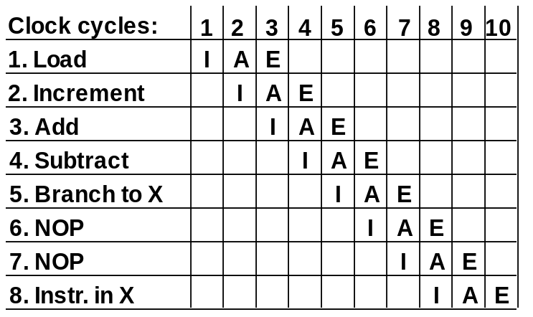
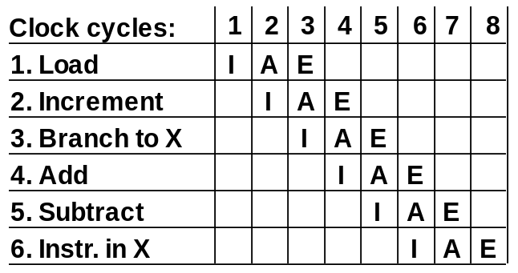
DELAYED BRANCH
RISC Pipeline
Compiler analyzes the instructions before and after
the branch and rearranges the program sequence by
inserting useful instructions in the delay steps
Using no-operation instructions
Rearranging the instructions

Slide 26
VECTOR PROCESSING
Vector Processing
Vector Processing Applications
Problems that can be efficiently formulated in terms of vectors
  Long-range weather forecasting
  Petroleum explorations
  Seismic data analysis
  Medical diagnosis
  Aerodynamics and space flight simulations
  Artificial intelligence and expert systems
  Mapping the human genome
  Image processing
Vector Processor (computer)
Ability to process vectors, and related data structures such as matrices
and multi-dimensional arrays, much faster than conventional computers
Vector Processors may also be pipelined

Slide 27
VECTOR PROGRAMMING
Vector Processing
DO 20 I = 1, 100
20 C(I) = B(I) + A(I)
Conventional computer
Initialize I = 0
20 Read A(I)
Read B(I)
Store C(I) = A(I) + B(I)
Increment I = i + 1
If I ≤ 100 goto 20
Vector computer
C(1:100) = A(1:100) + B(1:100)

Slide 28
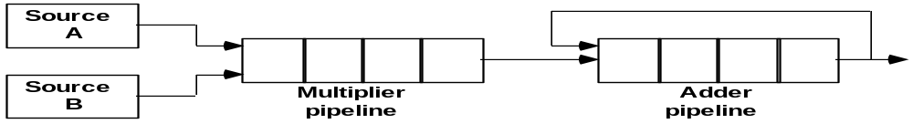
VECTOR INSTRUCTION FORMAT
Vector Processing
Vector Instruction Format
Pipeline for Inner Product of Matrix Multiplication
C= A₁ B₁ + A₅B₅ + A₉ B₉ + A₁₃ B₁₃ +…….+ A_{k} B_{k}
K may be equal to 100 or even 1000
The values of A and B are either in memory or in processor registers. Each floating
point adder and multiplier unit is supposed to have 4 segments. All segment
registers are initially initialized to zero. Therefore the output of the adder is zero
for the first 8 cycles until both the pipes are full.
Ai and Bi are brought in and multiplied at a rate of one pair per cycle. After 4 cycles
the products are added to the Output of the adder. During the next 4 cycles zero is added.
At the end of the 8th cycle the first four products A1B1 through A4B4 are in the four
adder segments and the next four products A5 B5 through A8B8 are in the multiplier
Segments.
Thus the 9th cycle and onwards starts breaking down the summation into four sections:

Slide 29
C= A₁ B₁ + A₅B₅ + A₉ B₉ + A₁₃ B₁₃ +…….
+ A₂ B₂ + A₆ B₆ + A₁₀ B₁₀ + A₁₄ B₁₄ +…….
+ A₃ B₃ + A₇ B₇ + A₁₁ B₁₁ + A₁₅ B₁₅ +…..
+ A₄ B₄ + A₈ B₈ + A₁₂ B₁₂ + A₁₆ B₁₆ +….
For Array processors and memory interleaving refer Morris Mano page number chapter 9 page no:324 and 326

